Slide 1

Network & Information Security
Group Project Presentation
Group 3：
71117130李雨峤 71117204刘雪珂
71117129魏旭凯 71117205丁婧伊
71117201姜子玥 71117206刘桂伶
71117203袁佳怡 71117207张晨旭

Slide 2
CONTENT
1
2
3
4
Locations&
Functions
Advantages&
Disadvantages
Contributions to
Securities
Work Division

Slide 3

Network & Information Security
ONE

Slide 4


DIFFERENCE BETWEEN
Mac
Windows

Slide 5

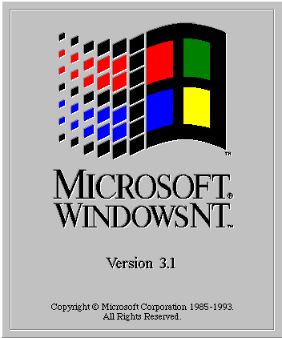


Locations & Functions
History:
Since Windows NT3.1 in 1993, Microsoft has been using event logs to record information about various events
Windows
Windows NT/Win2000/XP/Server 2003:
“%systemroot%\System32\config”
“xx.evt”

Slide 6


Locations & Functions
History:
Starting with Windows Vista and Server 2008, the name, structure, and storage location of the log files have changed dramatically
Windows
Windows Vista和Server 2008 —— now:
“%systemroot%\System32\WinEvt\logs”
“xx.evtx”

Slide 7
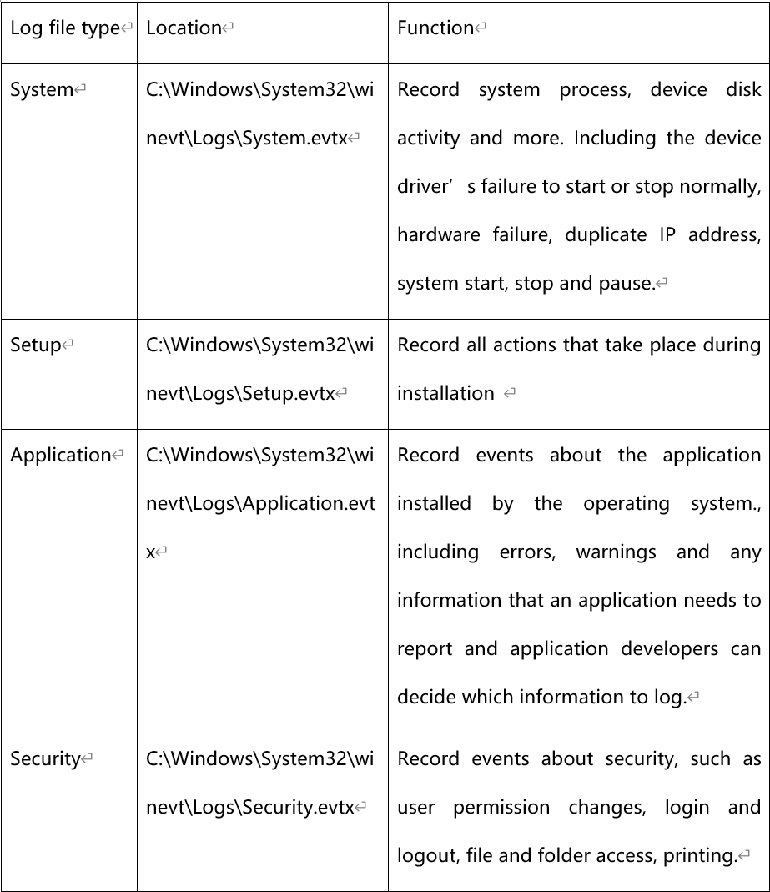
Locations & Functions
C:\Windows\System32\winevt\Logs
Windows

Slide 8
Log file types
Windows Logs
Records events generated by operating system components, including crashes of drivers, system components, and applications, and data.
Application Logs
Contains events that are recorded by an application or system program, primarily in terms of program execution.
Windows
Security Logs
Record system security audit events, including various types of login logs, object access logs, process tracking logs, privilege usage, account management, policy changes, system events.
Notes:
记录操作系统组件产生的事件，主要包括驱动程序、系统组件和应用软件的崩溃以及数据
包含由应用程序或系统程序记录的事件，主要记录程序运行方面的事件。
记录系统的安全审计事件，包含各种类型的登录日志、对象访问日志、进程追踪日志、特权使用、帐号管理、策略变更、系统事件。。

Slide 9
Locations & Functions
/var/log
Holds the Wi-Fi, kernel, File system repair, System and Installer log files
/Users/usrname/Library/logs
Holds User system repair and Copy CD log files
Mac
/usr/bin
Holds Power management, IORegistry and NVRAM log files
Notes:
第一部分存放与Wi-Fi、内核、文件系统修复、系统和安装相关的日志文件
第二部分存放用户系统修复、CD相关的日志文件
第三部分存放电源管理、IO、NVRAM相关的日志文件

Slide 10
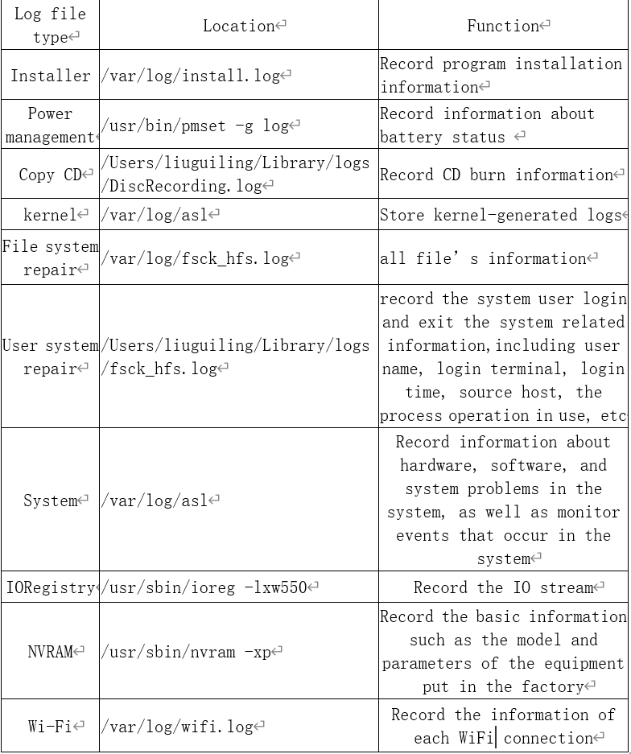
Locations & Functions
Mac

Slide 11
Network & Information Security
TWO

Slide 12
VS

Slide 13

Advantages of Windows log file
The information covered by the Windows event log files is relatively comprehensive and classified clearly
Windows Logs
——Covers information about systems, security, and applications
Win Log
Application & Service Logs
——Covers event information about basic tools and software such as Microsoft, Microsoft Office Alerts, Windows PowerShell, and Internet Explorer.
Notes:
Windows事件日志文件覆盖的信息比较全面，分类清晰。系统日志被分为两大类：Windows日志和应用程序和服务日志。前者覆盖了有关系统、安全、应用程序的信息，后者覆盖了Microsoft、Microsoft Office Alerts、Windows PowerShell、Internet Explorer等基础工具和软件的事件信息。

Slide 14
Advantages of Windows log file
In contrast to the Mac OS, there is a dedicated logging module for logging specific application information.
Windows log file system provides a module to record application-related event logs
2. Windows log file system design the corresponding log file modules for software and tools specific to Windows
IE log files
Powershell log files
IIS log files
…
Notes:
首先，Windows日志文件系统专门提供应用日志模块来记录与应用有关的事件。
其次，Windows日志文件系统针对Windows系统中特有的软件和工具设计了相应日志模块
IIS日志记录每打开一个网站的用户ip、web地址、访问时间、访问状态等信息。

Slide 15
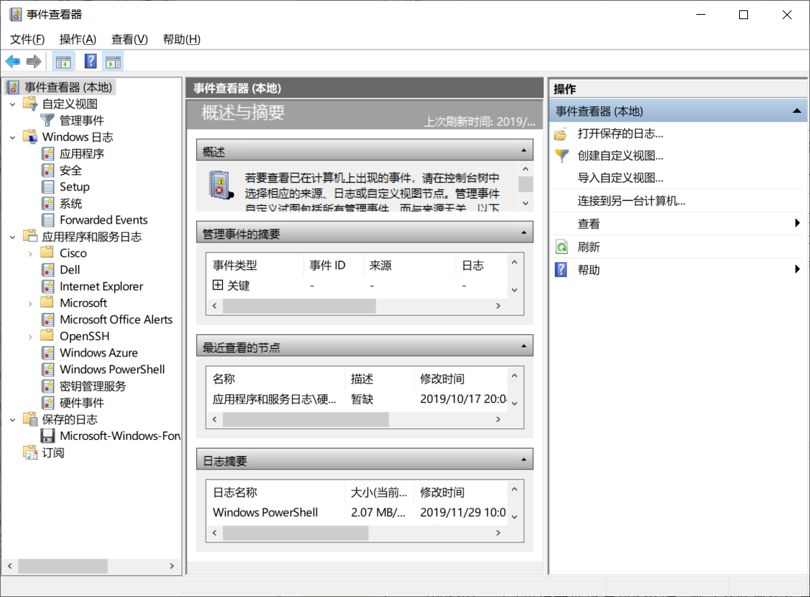
Advantages of Windows log file
Windows system comes with a log analysis tool called event viewer, clearly dividing log files into various types, making it convenient for users to view and manage relevant log information.
Notes:
Windows系统中自带了一个叫做事件查看器的日志分析工具，清晰地划分了多种日志类型，极大地方便了用户查看和管理相关日志信息

Slide 16
Disadvantages of Windows log file
Compared to Mac OS, it lacks log information on power management, CD, kernel, IO, NVRAM and Wi-Fi.
Event log files (evtx) are binary formats
require proprietary tools or programs to read and process them
binary log files are efficient in disk space utilization but cannot be compressed very much
Windows event log files have poor security, vulnerable to hacker attacks
with eventlogedit (a tool that threatens the security of log files), an attacker can remove a single event log entry from the security, application, and system logs on the target Windows system.
Notes:
1）相比于Mac OS缺少电源管理、CD、内核、IO、NVRAM、Wi-Fi方面的日志信息。
（2）事件日志（evtx）文件是一种二进制格式的文件，不仅需要专有的工具或程序去阅读或处理他们，而且其长期存储会给企业级用户带来许多挑战，比如二进制日志文件在磁盘空间利用上很高效，却无法进行很大的压缩。
（3）Windows事件日志文件安全性差，易受黑客攻击。比如使用eventlogedit，攻击者可以从目标Windows系统上的安全，应用程序和系统日志中删除单个事件日志条目。虽然恢复攻击者删除的事件日志条目方法已经被提出来，但Windows日志文件易受更改和删除的风险依然存在，其安全性依然不够完善。

Slide 17

Advantages of Mac log file
MAC OS has logs for basis functions, such as System、File system repair、Installer、User system repair
Notes:
MAC OS有对系统、硬件、安装、安全等基本功能进行记录的日志。

Slide 18
Advantages of Mac log file
All log files for MAC OS are respectively stored in three different paths. The classification is clear and easy to manage.
Holds the Wi-Fi, kernel, File system repair, System and Installer log files
/var/log
/Users/usrname/Library/logs
Holds User system repair and Copy CD log files
/usr/bin
Holds Power management, IORegistry and NVRAM log files
Notes:
MAC OS所有的日志文件分别存放在三个不同的路径下,分类清晰，便于管理。

Slide 19
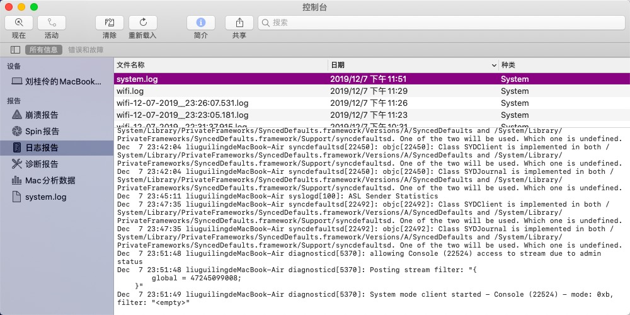
Advantages of Mac log file
The MAC OS system has a special tool for viewing log files.

Slide 20
Disadvantages of Mac log file
Compared with Windows system, MAC OS has relatively less management of application and network usage.
IE log files
Powershell log files
IIS log files
…

Slide 21

DAMEN POWEr
oeveroyouthfuloeveroweeping
THREE

Slide 22

Contributions to NS
The log file records every detail of the operation of the system and its various services. By continuously monitoring the log file entries, intrusions can be detected, helping us understand and avoid some disasters
In network communication, analysis of various login events can effectively find evidence of hackers trying to log in and intrusion of information. At the same time, if the system finds abnormal login log information, it can prevent in time and notify users to pay attention to security
If a hacker hacks, it may modify the user's security protection measures and operate on the file information. These operations will leave a record in the system log. By analyzing these log files, users can learn which security measures have been modified, and which information has been stolen. It helps provide available data for handling incident.
The maintenance personnel can quickly locate the faults and check the causes of them to let network perform well through analyzing log files. At the same time, log files provide the trace to track the attacker to strengthen the network security level and improve the network security performance
Notes:
日志文件记录了系统及其各种服务的每个细节。通过不断地监视日志文件条目，可以检测到入侵，帮助我们理解和避免一些灾难
在网络通信中，通过对各种登录事件的分析，可以有效地发现黑客试图登录和信息入侵的证据。同时，如果系统发现登录日志信息异常，可以及时阻止并通知用户注意安全
如果黑客入侵，可以修改用户的安全保护措施，对文件信息进行操作。这些操作将在系统日志中留下记录。通过分析这些日志文件，用户可以了解哪些安全措施被修改了，哪些信息被窃取了。它有助于为处理事件提供可用的数据
通过对日志文件的分析，维护人员可以快速定位故障并查找故障原因，使网络运行良好。同时，日志文件提供了对攻击者的跟踪，增强了网络安全水平，提高了网络安全性能

Slide 23


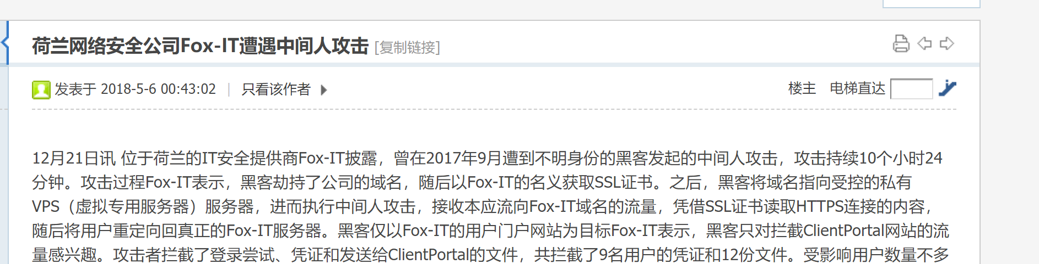
“eventlogedit”——Hacking tool provided by NSA?

Slide 24
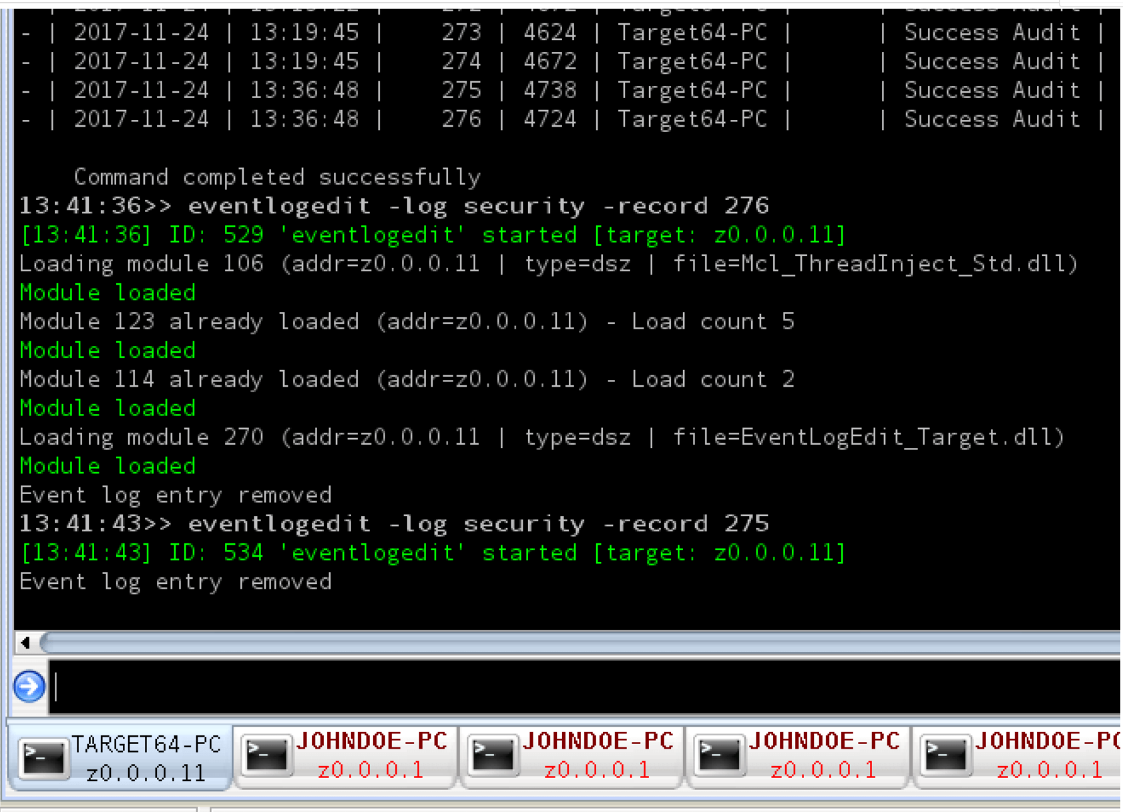
“eventlogedit”——Hacking tool provided by NSA?
“DanderSpritz”——NSA cyber weapon framework
“Shadow Brokers”
Notes:
Windows事件日志文件的内容对于系统管理员对系统性能的故障诊断、安全小组对事件的监视以及调查违规或欺诈案件的法医和事件响应小组非常有用
丢失事件记录可能会降低发现攻击的可能性，或妨碍调查

Slide 25
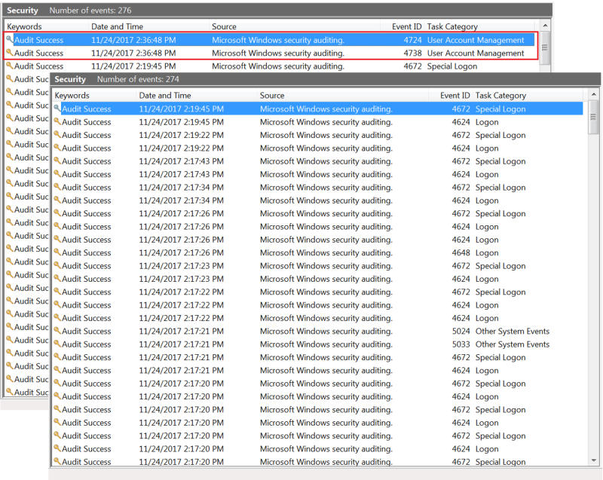
“eventlogedit”——Hacking tool provided by NSA?
Eventlogedit:
a piece of software capable of removing individual lines from Windows Event Log files

Slide 26
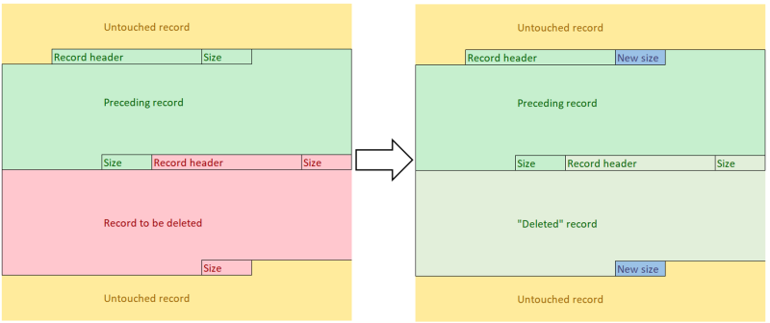
How does “eventlogedit” work
Recover

Slide 27
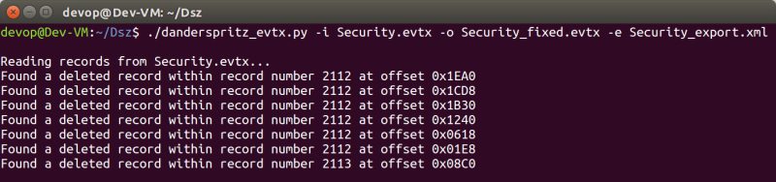
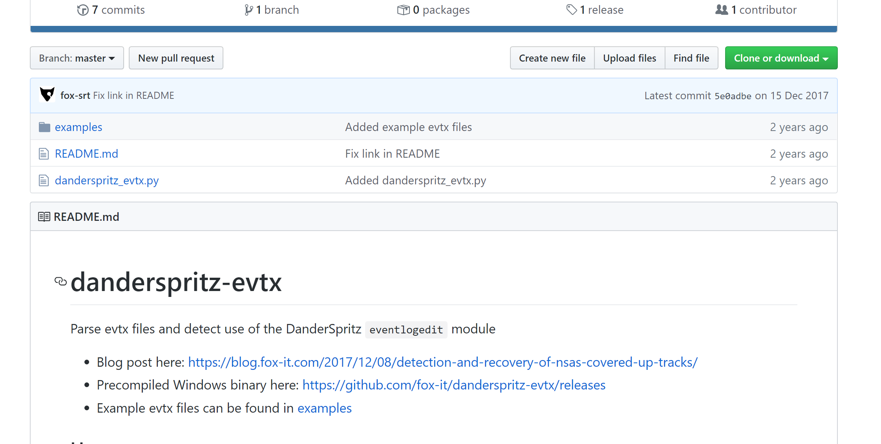
Recover the origin record
Github:
https://github.com/fox-it/danderspritz-evtx

Slide 28

What can we learn?
Always be aware of your private information security. Even your country can be your prier!
There is no permanent security defense method. We should keep pace with the times and learn how to protect ourselves.

Slide 29
FOUR

Slide 30

Division of work
姜子玥 刘桂伶：Task2 & Task6
丁婧伊 刘雪珂：Task3
魏旭凯 袁佳怡：Task4
张晨旭：Task5
李雨峤：PPT preparation & speech
Research and Analyze

Slide 31

THANKS
求Pick!

